Slide 1
buildingSMART
industry solutions organisation
Jim Plume
Geotechnical Data Standardization Workshop, Paris, 22-24 January 2019

Slide 2

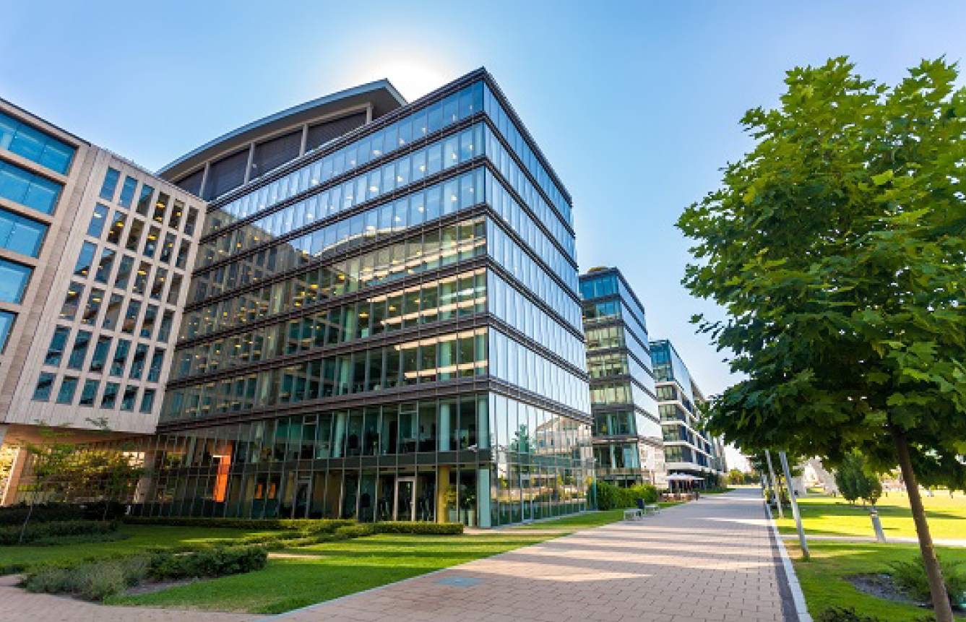
Industry solutions organisation

Slide 3
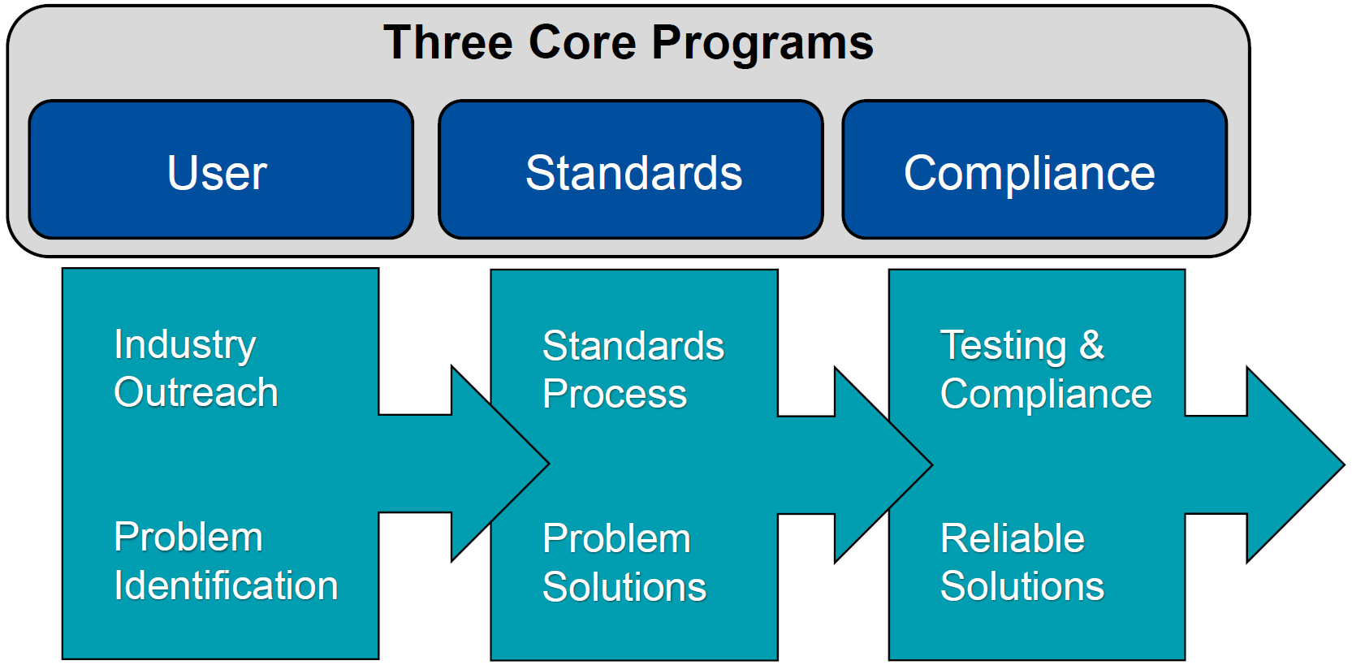
User-driven Process

Slide 4
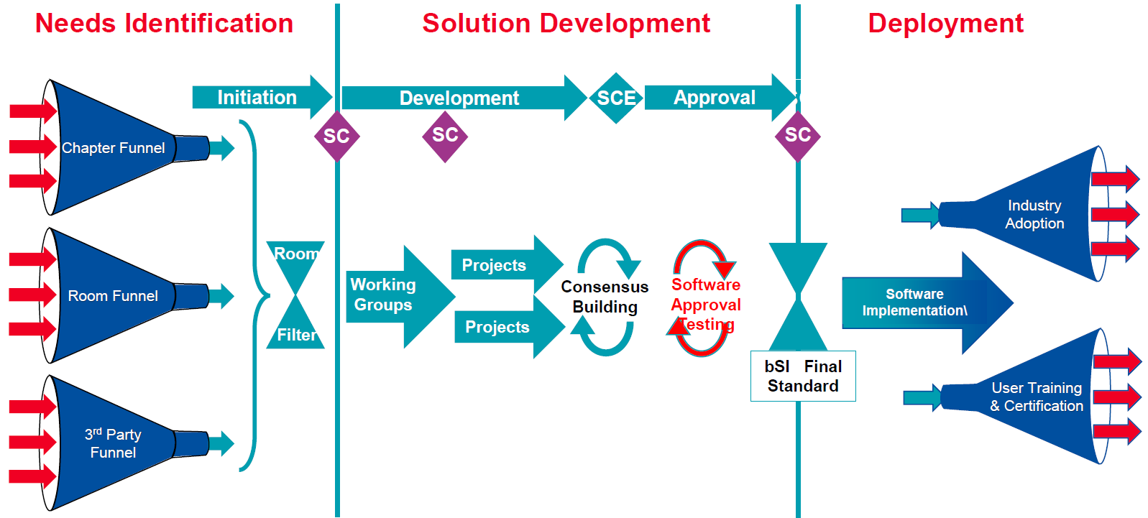
bSI Standards Process

Slide 5
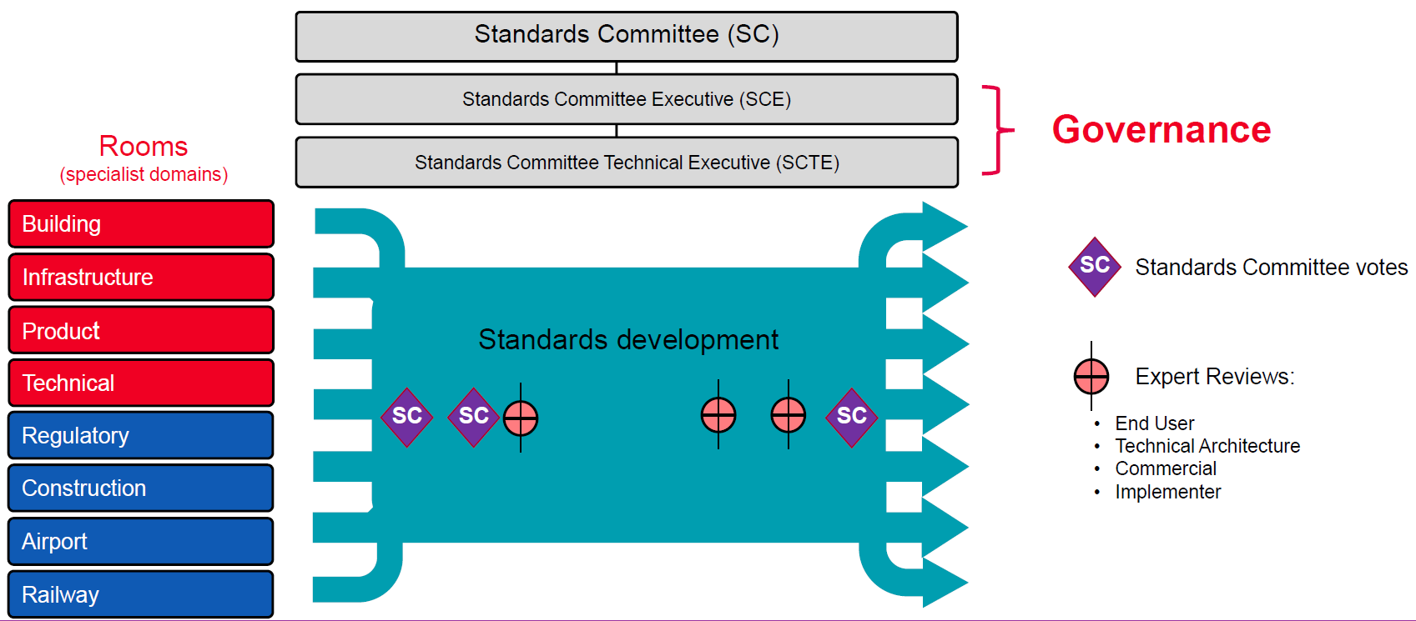
bSI Standards Process Organisation

Slide 6
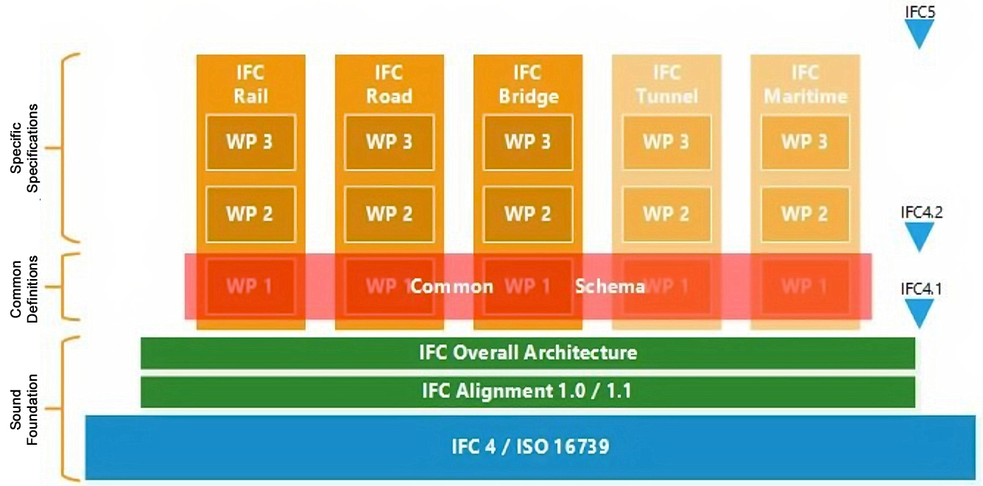
Linear Infrastructure Work Program
Source: buildingSMART International

Slide 7
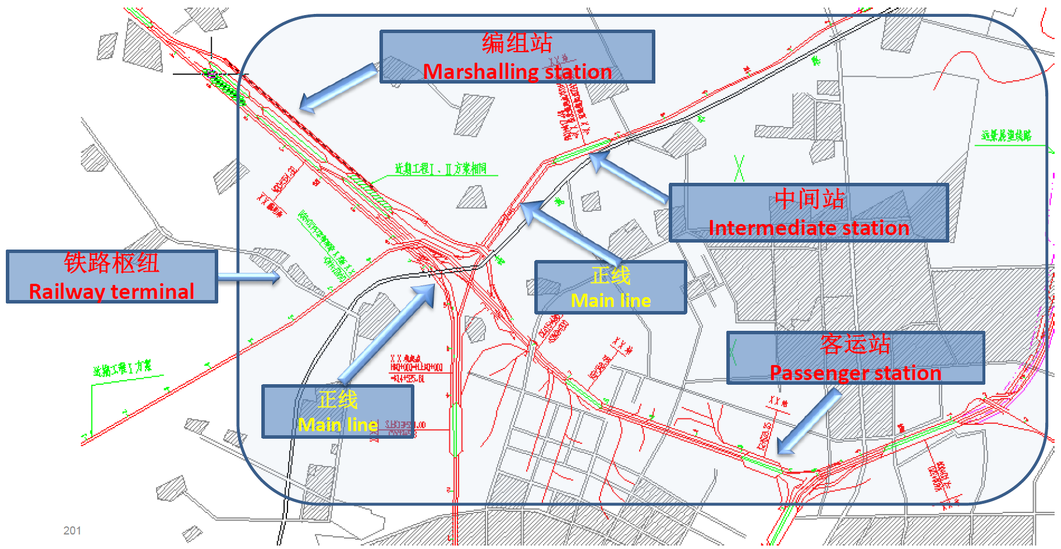
ifcRail Project
Source: buildingSMART International

Slide 8
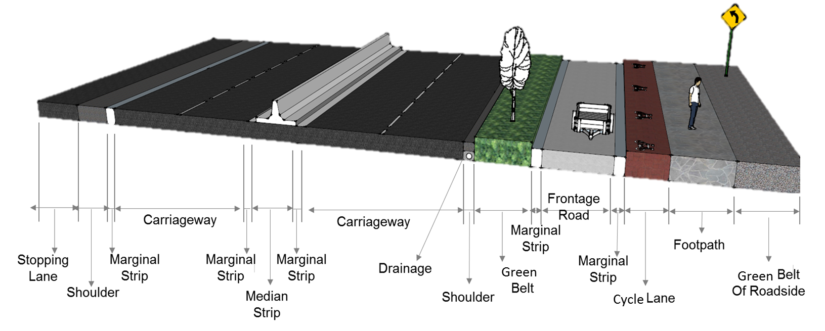
ifcRoad Project
Original Source: KICT
Source: buildingSMART International

Slide 9
ifcBridge Project
Carried system
Carried Elements
Superstructure
Substructure
Temporary works
Supporting system
(Superstructure)
(MINnD Project)
Load-bearing system
Foundation system
(Substructure)
Source: buildingSMART International

Slide 10
Geotechnical Standardization in IFC
Part of the IFC Common Schema project
Succinct and fit for purpose
Recognising the geospatial domains
International in scope

Slide 11
Thank you!

